Slide 1
File Management

Slide 2
File
File is a named collection of related information that is recorded on a secondary storage.
Attributes:
  Name
  Identifier
  Type
  Location
  Size
  Protection – permissions
  Time, date and user identification

Slide 3
File Operations
  Creation
  Writing
  Reading
  Repositioning
  Deleting
  Truncating
Access Methods
  Sequential Access
  Direct Access

Slide 4
Directory
A directory contains information about files
  Name
  Location
  Type
  Size etc
Directory
files
Directory
Files
Partition B
Disk 1
Partition A

Slide 5
Operations on a Directory
Search for a file
Create a file
Delete a file
List a directory
Rename a file
Traverse the file system

Slide 6
Directory Implementation
Linear List
  Simple to program
  Time consuming to execute
  Create new file
    Make sure it’s a unique file name
    Add entry at end of directory
  Delete a file
    Search for the file
    Release the space allocated to it
    Mark the space as unused or attach it to list of free directory entries or copy the last directory entry here.

Slide 7
2. Hash Table
  Linear list + hash structure
  Compute hash value of file names
  Decreases search time
  Collisions are to be avoided
  Disadvantage – hash functions are of fixed size (0-64 or 0-128 etc)

Slide 8
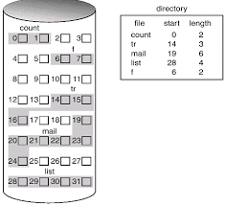
Contiguous Allocation
  File occupy contiguous blocks
  Directory entry contains
    File name
    Starting block
    Length (total blocks)
  Access possible
    Sequential
    Direct
  Problems
    Finding space for new file
    External fragmentation
    Determining space requirement of a file

Slide 9
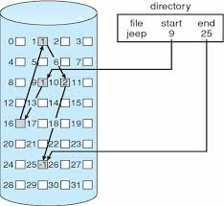
Directory structure contains
  Pointer to first and last block of file
Advantages
  No external fragmentation
  No issue with increase in file size
Disadvantages
  Only sequential access
  Reliability – loss of a pointer
  Space required for pointers
  Solution: make cluster of blocks
    Problem: internal fragmentation

Slide 10
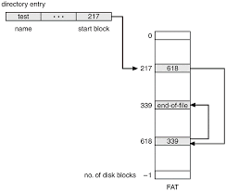

Slide 11
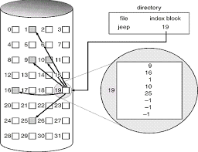
Indexed Allocation
Clubs all the pointers into one block – index block
Directory entry contains
  File name
  Index block number
Access
  Direct
Issue
  Size of index block
  Sol: multilevel indexing

Slide 12
Performance
Contiguous
  Requires only 1 access to get a disk block
Linked
  Requires i disk reads to read i^{th} block
Indexed
  Depends on
    level of indexing
    Size of file
    Position of desired block

Slide 13
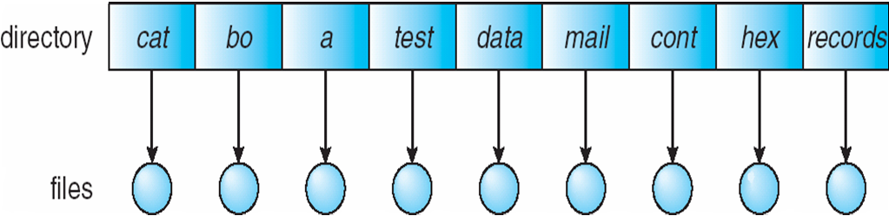
Single-Level Directory
A single directory for all users
Easy to support and understand.
Limitation:
When number of files increases or when the system has When number of files increases or when the system has more than one user, then Naming problem occurs. All files should have unique names.

Slide 14
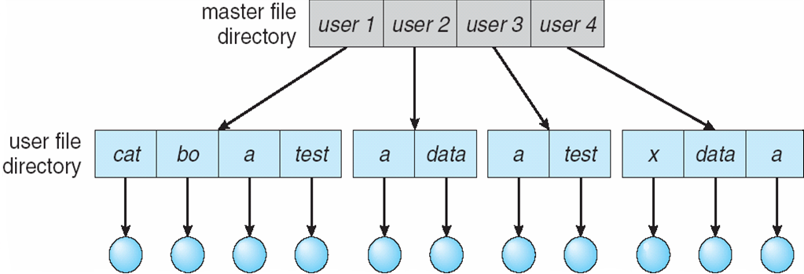
Two-Level Directory
In two level directory, each user has his own user file directory(UFD). UFDs have the similar structure, but each lists only the files of a single user.
Path name
Can have the same file name for different user
Efficient searching

Slide 15
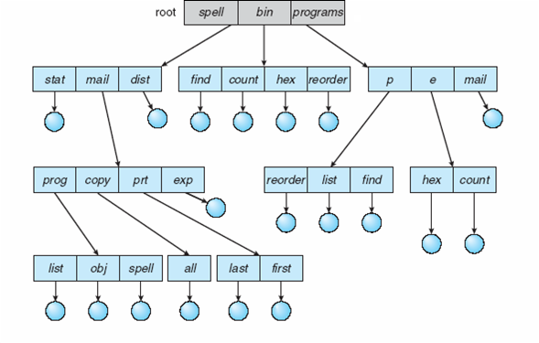
Tree-Structured Directories

Slide 16
Tree-Structured Directories (Cont)
Absolute or relative path name
Creating a new file is done in current directory
Delete a file
rm <file-name>
Creating a new subdirectory is done in current directory
  mkdir <dir-name>
Example: if in current directory /mail
mkdir count
mail
prog
copy
prt
exp
count
Deleting “mail” ⇒ deleting the entire subtree rooted by “mail”

Slide 17
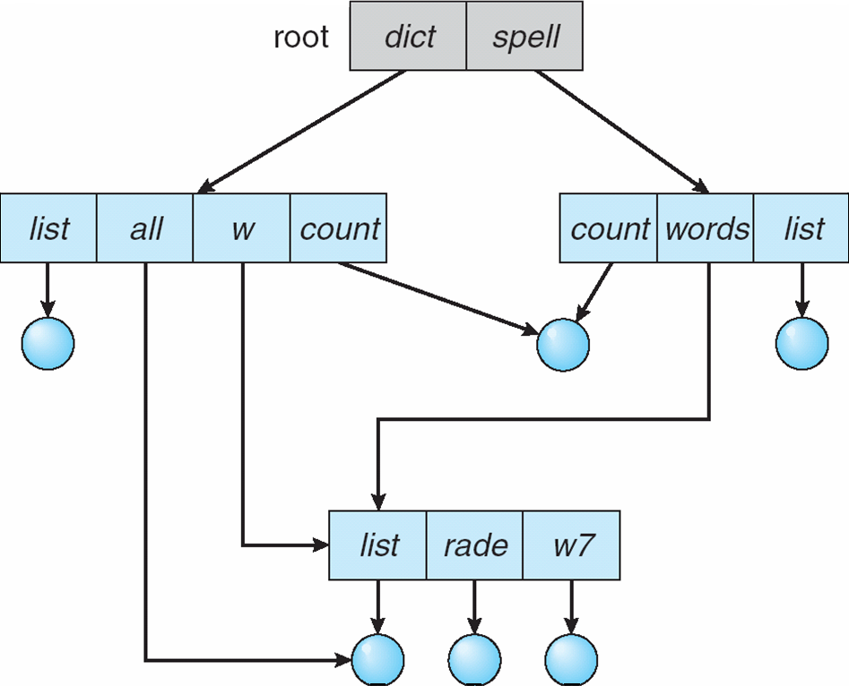
Acyclic-Graph Directories
Have shared subdirectories and files

Slide 18
Free Space management
Bit vector
Linked list
Grouping
Counting

Slide 19
Bit vector
Free space is implemented using bit vector
Each block is represented by 1 bit
1 means free
0 means allocated
E.g 0011110011111100101100000…………
Advantage
  Simple
  Easy to find first free block
  Easy to find n consecutive free blocks
Disadvantage
  Entire vector is to be kept in main memory – not possible for larger disks
  1-Tb disk with 4Kb block size requires 32 Mb to store bit map

Slide 20
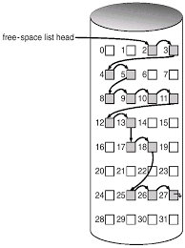
Linked List
Link all the free blocks
Keep pointer to first free block in disk
Disadvantage
  Traversal is not easy

Slide 21
Grouping
Store addresses of n free blocks in the first free block
The first n-1 out of these are free while nth block contains addresses of another n free blocks.

Slide 22
Counting
When several blocks are freed or allocated simultaneously
Keep address of first free block and the number(n) of free contiguous free blocks that follow
Adv.
  Easy to locate group of free blocks

